Slide 1
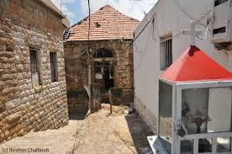
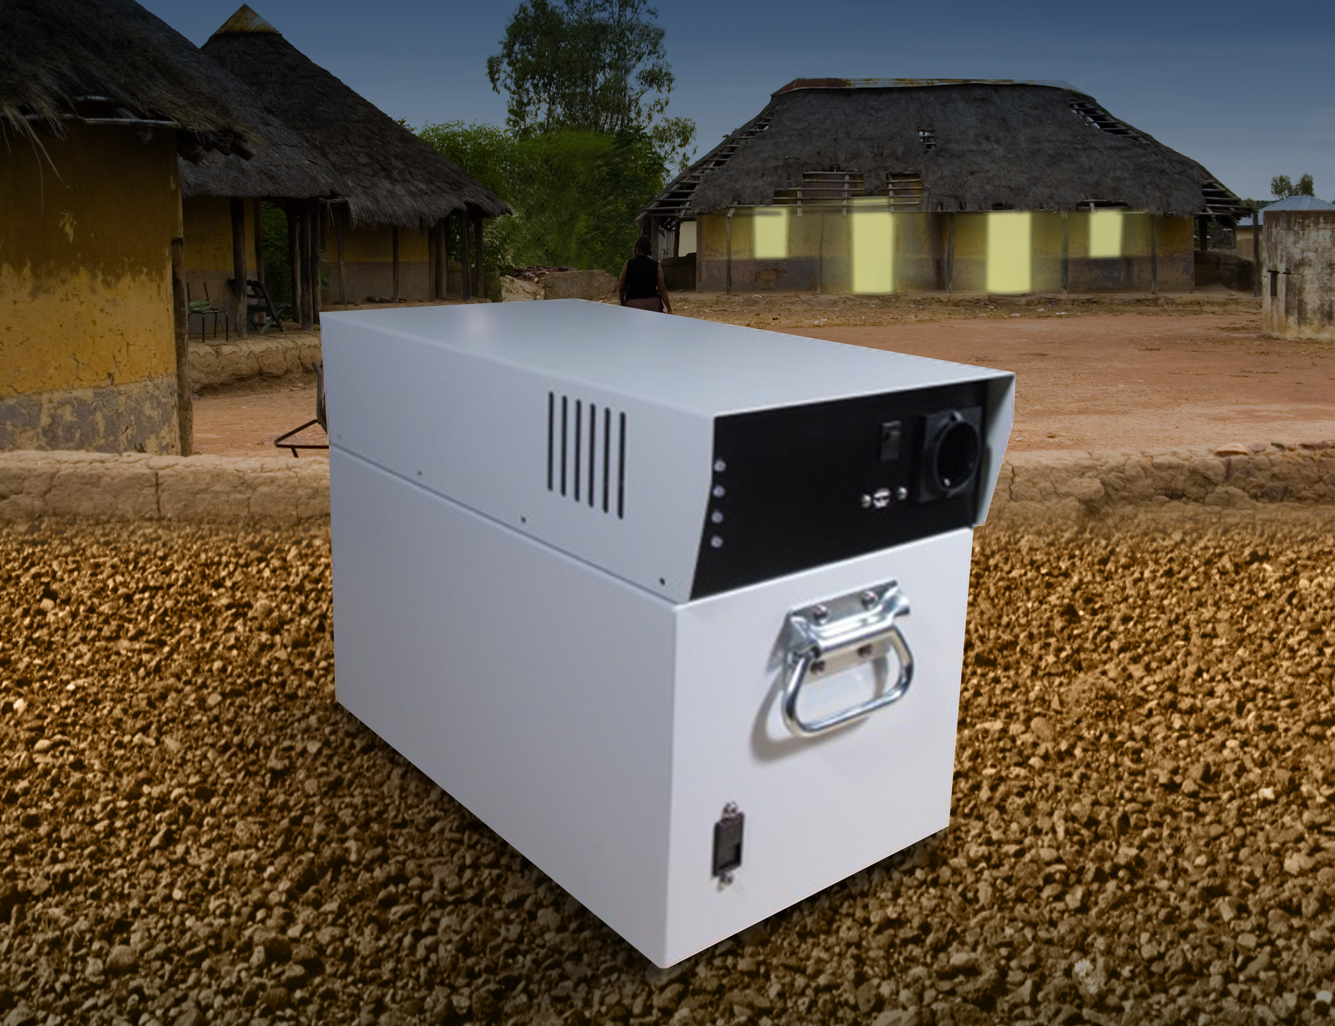
Solar Grid - Elonglife Project in SOMALIA
Study
For Mr XXX and Mr YYY
29 May 2015
E-Longlife, Inc. Proprietary Information (Cleared for Export)

Slide 2
Low consumption profile of homes in Somalia
For what ?
Fridge 24hrs/7days
5 LEDs light bulbs during 5hrs at night
TV –LCD display during 3hrs the day + 5hrs at night
Fan during 6hrs the day and 3hrs night
Computer/Laptop during 4 hrs the day and 3hrs at night
Miscellaneous : Mobile phone – charge everyday…etc
E-Longlife, Inc. Proprietary Information (Cleared for Export)
2
27/05/2015

Slide 3
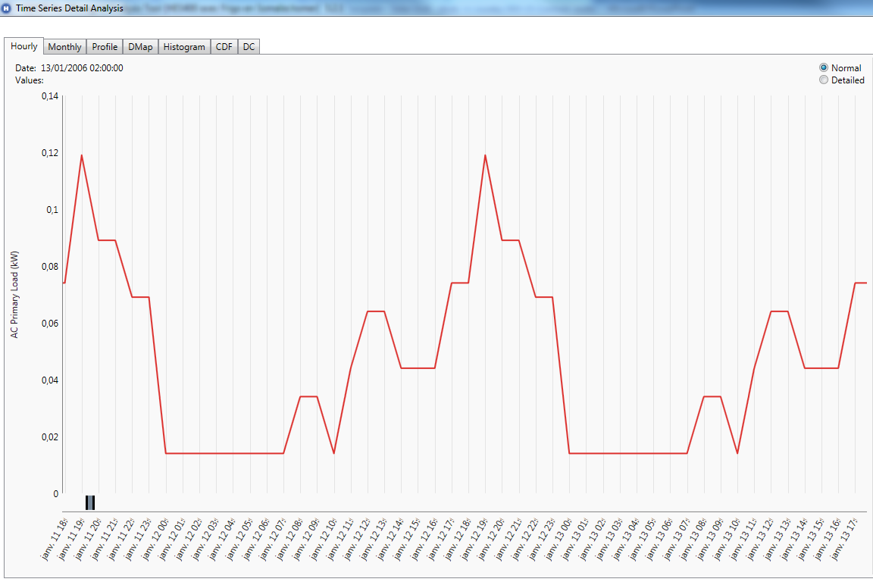
Low consumption profile of homes in Somalia
At what time?
Consumption (Kw)
Fridge/lights/TV/Fan/Computer/Laptop/Mobile phone..
E-Longlife, Inc. Proprietary Information (Cleared for Export)
3
27/05/2015

Slide 4
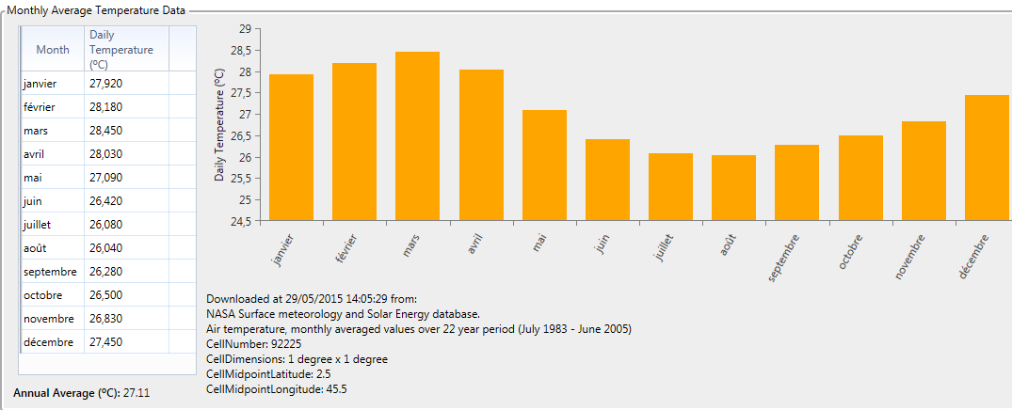
Temperature conditions in Mogadishu - SOMALIA
Average is 27°C
Average Min Temperature is 26°C and Max Temperature is 28 °C
E-Longlife, Inc. Proprietary Information (Cleared for Export)
4
27/05/2015

Slide 5
Elonglife Home Energy System HES400 - SOMALIA Typical/average day
Lithium battery
State of charge (%)
Solar Energy
(Kw)
Home consumption
(Kw)
Fridge/(5)Lamps/TV/FAN/
Computer/Mobilephone
E-Longlife, Inc. Proprietary Information (Cleared for Export)
5
27/05/2015

Slide 6
Elonglife Home Energy System HES400 - SOMALIA Particular day (bad weather)
Lithium battery
State of charge (%)
Solar Energy
(Kw)
Home consumption
(Kw)
Fridge/(5)Lamps/TV/FAN/
Computer/Mobilephone
E-Longlife, Inc. Proprietary Information (Cleared for Export)
6
27/05/2015

Slide 7
Elonglife Home Energy System HES400 - SOMALIA Throughout the year
Lithium battery
State of charge (%)
Solar Energy
(Kw)
E-Longlife, Inc. Proprietary Information (Cleared for Export)
7
27/05/2015

Slide 8
Option 1 : HES400 with shortage max 1% (with fridge) or No shortage (without fridge)
System configuration:
PV 250 Wc x 3 : 750Wc
Elonglife HES400, including Lithium battery
Results :
Energy Production over 12 months : 1250 kWh (100% Solar)
Energy consumption over 12 months : 392 kWh
Shortage of 3,3 kWh max over 12 months
Average Min SoC > 25 %
Total Cost
Elonglife HES400 + 3 x Solar Panels = 1 855$, for qty Min 50 000 units.
10 years Energy production garantee
Min 20 years lifespan with Maintenance Program Service Plan
E-Longlife, Inc. Proprietary Information (Cleared for Export)
8
27/05/2015

Slide 9
Option 2 : HES400 with max 1% shortage & without Fridge
System configuration:
PV 250 Wc x 2 : 500Wc
Elonglife HES400, including Lithium battery
Results :
Energy Production over 12 months : 833 kWh (100% Solar)
Energy consumption over 12 months : 271 kWh
Shortage of 0,5 kWh max over 12 months
Average Min SoC > 50%
Total Cost
Elonglife HES400 + 2 x Solar Panels = 1 720 $USD, Min quantity 50 000 units
10 years Energy production garantee
Min 20 years lifespan with Maintenance Program Service Plan
E-Longlife, Inc. Proprietary Information (Cleared for Export)
9
27/05/2015

Slide 10
To contact us
Hajem Moncef
Directeur Général GPE
Global Produits Energétiques
26 AV de l’UMA 2035 Tunis Carthage . ARIANA Tunisie
Télé: + 216 71 940 200
Fax: +216 71 940 964
Email: hajem.moncef@gpe.com.tn
Site web: www.gpe.com.tn

